Slide 1
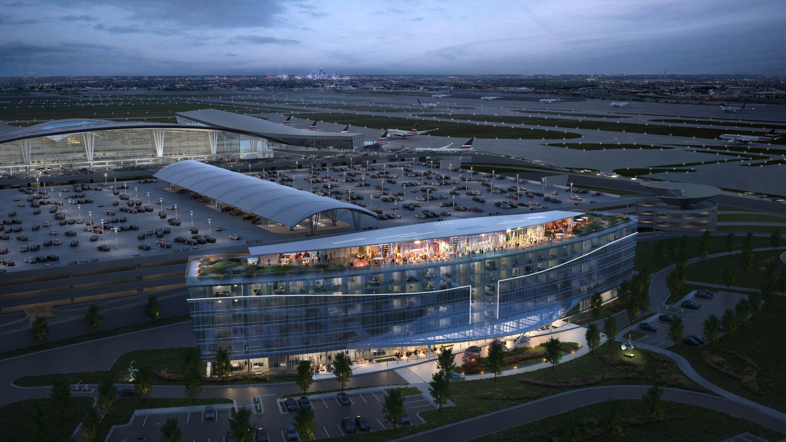

Terminal Connected
Hotel
August 28, 2024

Slide 2

Welcome and Introductions
  Welcome
  Chelci Hunter – Program Manager, Business Equity & Opportunity
  Brad Bobich, PE – Project Director – Planning & Development POC
  Design/Construction Partners
  IAA: Jonathan Weinzapfel, Project Executive
  Jarod Klaas, Senior Director, Planning & Development
  Shiel Sexton: Construction Manager as Constructor (CMc)
  Matt Barnes – POC
  Ryan Sermershiem – Project Executive
  Jordyn Meisberger – Project Manager
  Other Partners: CSO (Architect)
  Wischermann Partners (Operator)
  CHMWarnick (Asset Manager)
  RW Purchasing (Purchasing Agent)
  AllBridge (IT Integrator)
  The Louderback Group (Hotel Consultant)

Slide 3
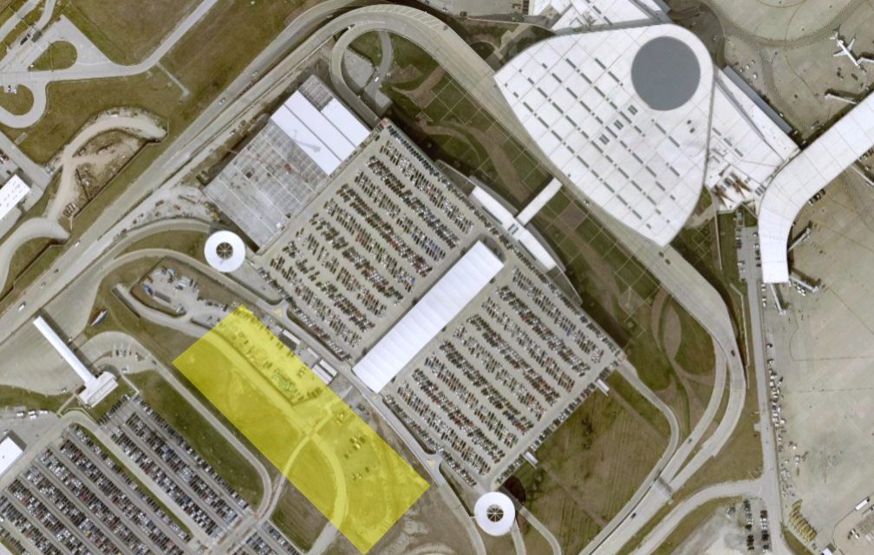
Overview of Project
The IAA is finalizing the design of a Terminal Connected Airport Hotel located on the west side of the existing Terminal Parking Garage. The current program includes:
Approximately 253 keys
Full-service 3-meals/day restaurant (1st floor)
Fitness Center (7th Floor)
Bar/Lounge Area (7th Floor)
Approx. 10,000 sf of Meeting/Banquet spaces
Pedestrian passage through the Hotel to the garage for IAA customers and employees
Hotel specific parking with valet option
Marriott Westin - Brand
LEED
Guest Floor located on Floors 2 through 6
Approximately 225,000 square feet

Slide 4
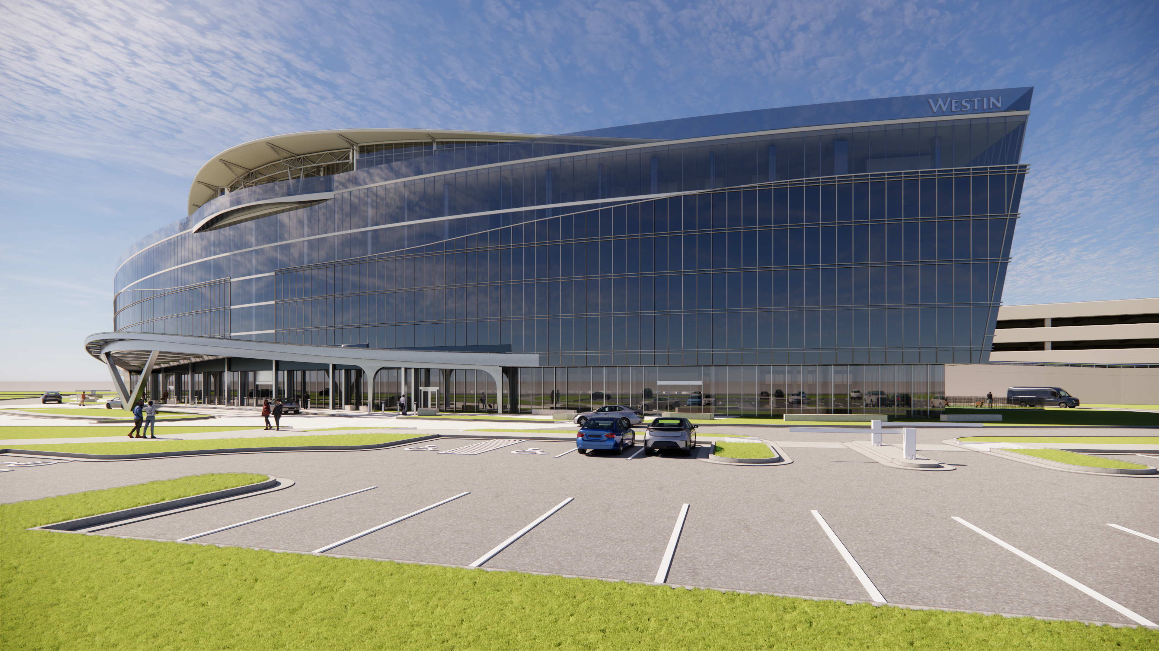
Schedule
Design Completion: End of August/September
Release of Bidding Documents: September/October
Bids Due: October/November

Slide 5
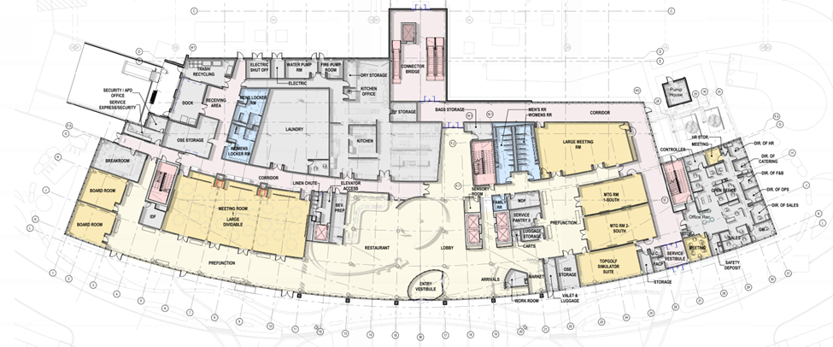
“Current” Design Plans
1st Floor

Slide 6
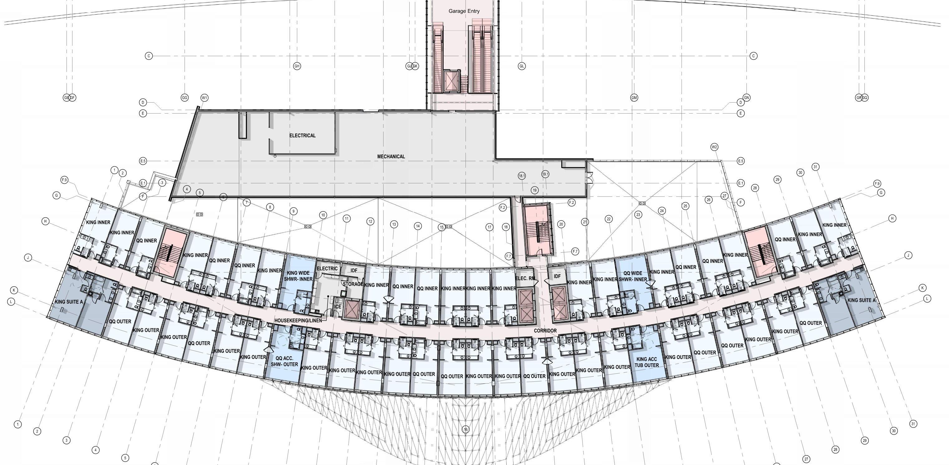
“Current” Design Plans
2nd Floor

Slide 7
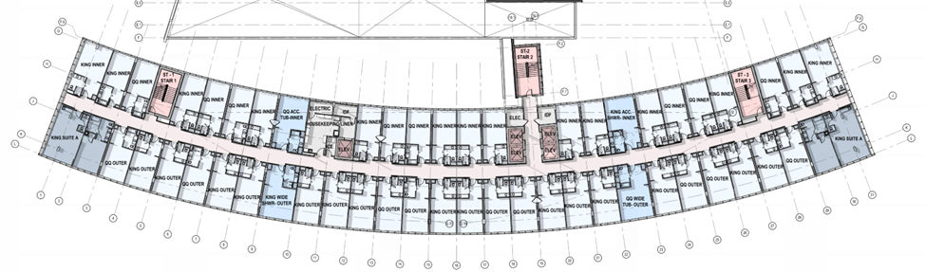
“Current” Design Plans
Typical 3rd thru 6th Floors

Slide 8
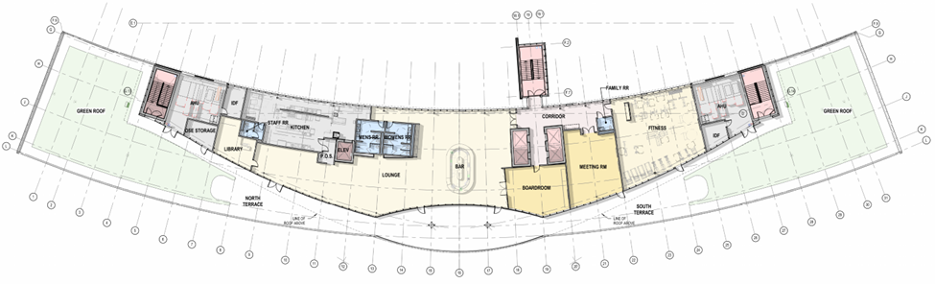
“Current” Design Plans
7th Floor

Slide 9
Design Renderings

Slide 10
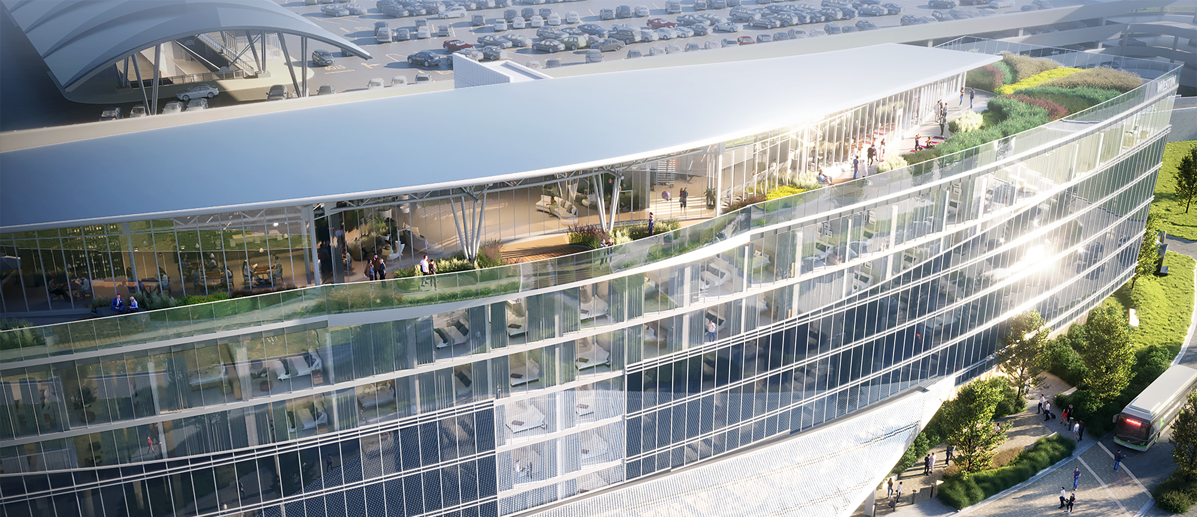
Design Renderings

Slide 11
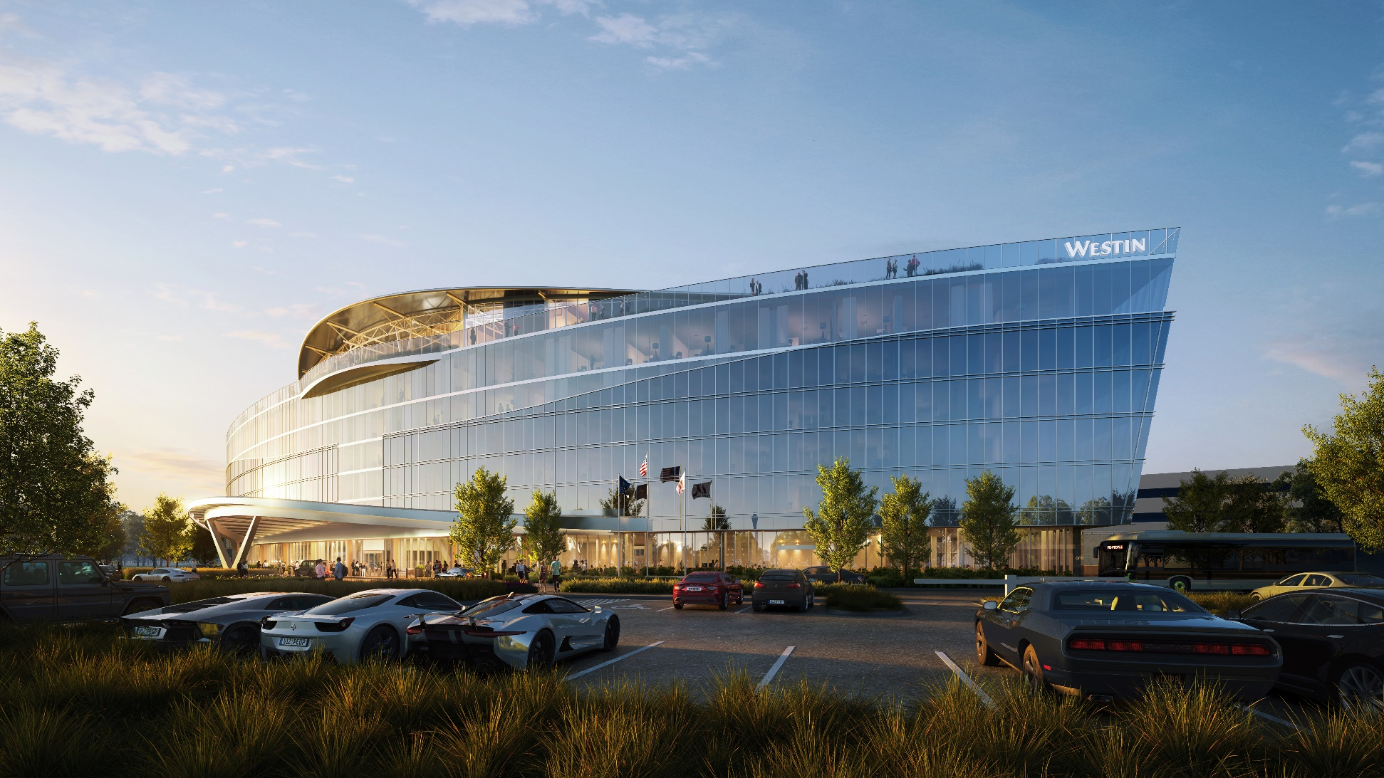
Design Renderings

Slide 12
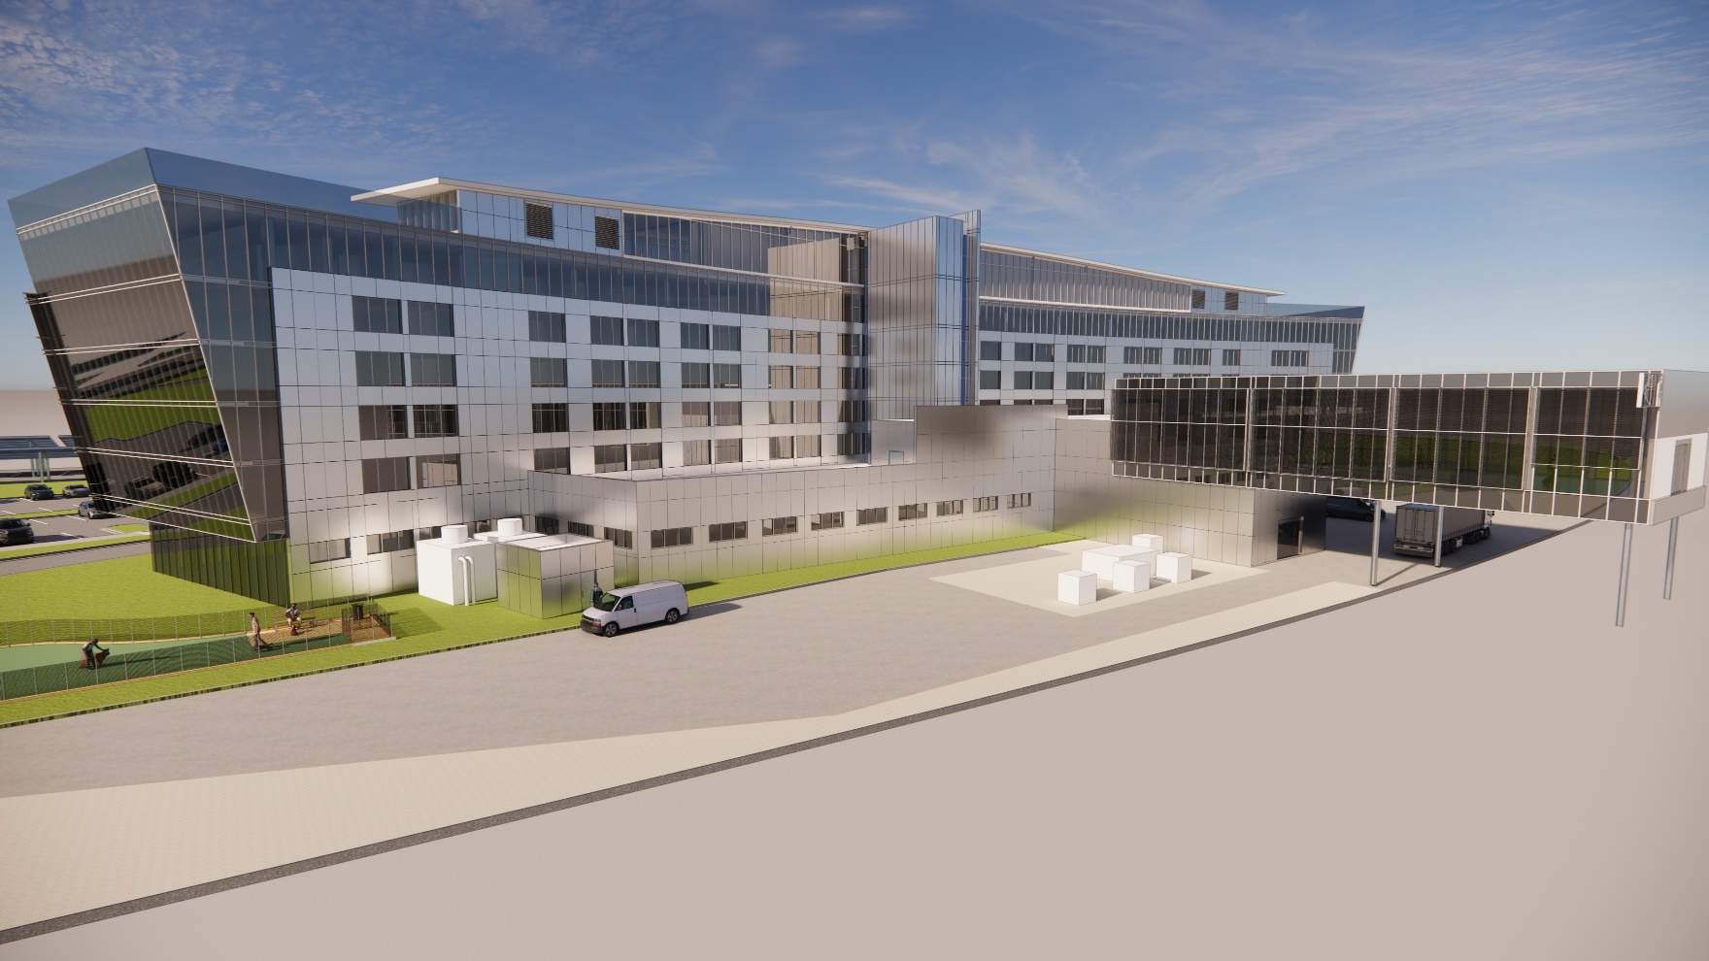




Bid Opportunities
WHAT CAN WE DO NOW?
SHIEL SEXTON
PREQUALIFICATION
IDOA
PREQUALIFICATION
PROJECT
SURVEY

Slide 13
Bid Opportunities
IMPORTANT DETAILS
Davis – Bacon Wage Scale
Bid Bonds – 5% of Bid Amount
Performance Bonds for 100% of Contract Amount (Tier 1 Contractors—Contracted w/SSC)
Tax Exempt
Work is outside of Airport Operations Area (AOA)
Subcontracts will be direct with Shiel Sexton Company
Prequalified with Indiana Department of Administration (IDOA)

Slide 14
Bid Opportunities
01.0—Temp. Pedestrian Walkway - Concrete
02.0—Temp. Fencing
03.0—Temp. Electric - Site
04.0—Asphalt Paving
05.0—Site Concrete
06.0—Landscaping
07.0—Fence and Gates
08.0—Unit Pavers
09.0—Parking Control Equipment
10.0—Structural Steel
11.0—Masonry
12.0—Elevators/Escalators
13.0—Roofing
14.0—Metal Panels
15.0—Green Roofing System
16.0—Aluminum Entrances & Storefronts
17.0—Food Service Equipment
18.0—Laundry Equipment
19.0—Ornamental Railings
20.0—Westin Signage - Interior
21.0—Westing Signage - Building
22.0—Code Signage
23.0—Waterproofing & Joint Sealants
24.0—Finish Carpentry/Arch Woodwork
25.0—Tiling
26.0—Soft & Resilient Flooring
27.0—Painting and Wall Covering
28.0—Wood Flooring
29.0—General Trades – Cranes/Hoists
30.0—General Trades - Doors
AND MULTIPLE OTHERS

Slide 15
High Level Estimated Schedule

Slide 16

AIRPORT DIVERSITY GOALS
OVERALL GOAL = 28%
MBE
15%
WBE
10%
VBE
3%

Slide 17
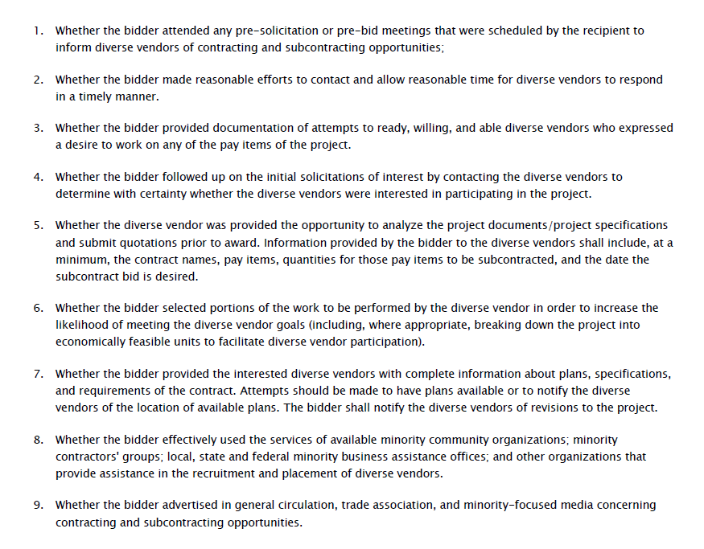



Good Faith Efforts
Did you have a plan?
How well is it documented?
Self-performance is not an excuse.

Slide 18

THANK YOU!
Open Discussion
CONNECT WITH US: SUPPLIERDIVERSITY@IND.COM

